Slide 1
Lists Part 2
- By
Hemlata Kohin

Slide 2
Last Class We Covered
• Value-returning functions
–None
–Common errors
• Function scope

Slide 3
Today’s Objectives
• To review what we know about lists already
• To learn more about lists in Python
• To understand two-dimensional lists
–(And more dimensions!)
• To practice passing lists to functions
• To learn about mutability and its uses

Slide 4
Vital List Algorithm: Iterating
• Write the code to iterate over and print out the contents of a list called classNames
index = 0
while index < len(classNames):
print( classNames[index] )
index += 1

Slide 5
Two-Dimensional Lists

Slide 6
Two-Dimensional Lists
• Lists can hold any type (int, string, float, etc.)
–This means they can also hold another list
• We’ve looked at lists as being one-dimensional
–But lists can also be two(or three-or four-or five-, etc.)
dimensional!

Slide 7
Two-Dimensional Lists: Syntax
• We use square brackets to indicate lists
–2D lists are essentially a list of lists
–What do you think the syntax will look like?
twoD = [ ["first", "row"],
["second", "row"],
["last", "row"] ]

Slide 8
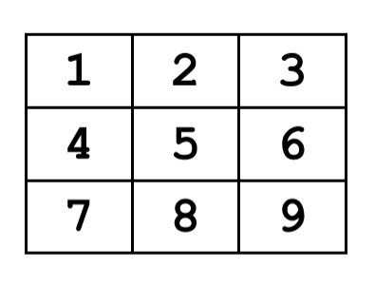
Two-Dimensional Lists: A Grid
• It may help to think of 2D lists as a grid
twoD = [ [1,2,3], [4,5,6], [7,8,9] ]

Slide 9
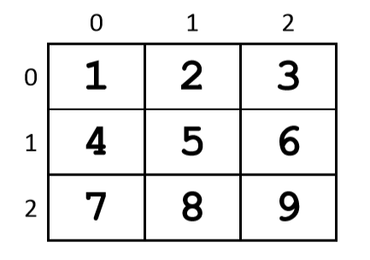
Two-Dimensional Lists: A Grid
• You access an element by the index of its row, and then the column
–Remember –indexing starts at 0!

Slide 10
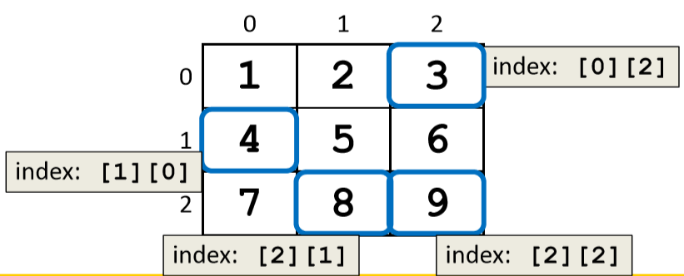

Slide 11
Lists of Strings
• Remember, a string is like a list of characters
• So what is a list of strings?
–Like a two-dimensional list!
• We have the index of the string (the row)
• And the index of the character (the column)

Slide 12
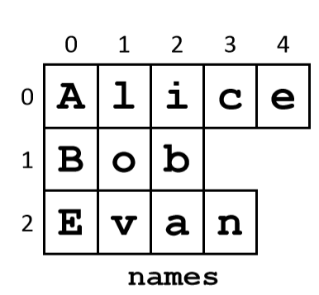
Lists of Strings
• Lists in Python don’t have to be rectangular
–They can be jagged (rows of different lengths)
• Anything we could do with a one-dimensional list, we can do with a two-dimensional list
–Slicing, index, appending

Slide 13
Vital List Algorithm: 2D Creating
• Write the code to create a 2D list of symbols called gameBoard, given width and height
gameBoard = []
while len(gameBoard) < height:
boardRow = []
while len(boardRow) < width:
boardRow.append(".")
gameBoard.append(boardRow)

Slide 14
Vital List Algorithm: 2D Iterating
• Write the code to iterate over and print out the contents of a 2D list called gameBoard
row = 0
while row < len(gameBoard):
col = 0
while col < len( gameBoard[row] ):
print( gameBoard[row][col], end = " ")
col += 1
print() # print a newline at end of each row
row += 1

Slide 15
Any Questions?

